Slide 1

Software Engineering
Lecture 11: Software Architecture

Slide 2
Software architecture
Software architecture refers to the
high level structures of a software system
discipline of creating such structures,
and the documentation of these structures.
These structures are needed to reason about the software system.

Slide 3
Software Architecture
A software architecture defines:
the components of the software system
how the components use each other’s functionality and data
How control is managed between the components
Notes:
The fundamental problem to be solved with a large system is how to break it into chunks manageable for human programmers to understand, implement, and maintain.

Slide 4
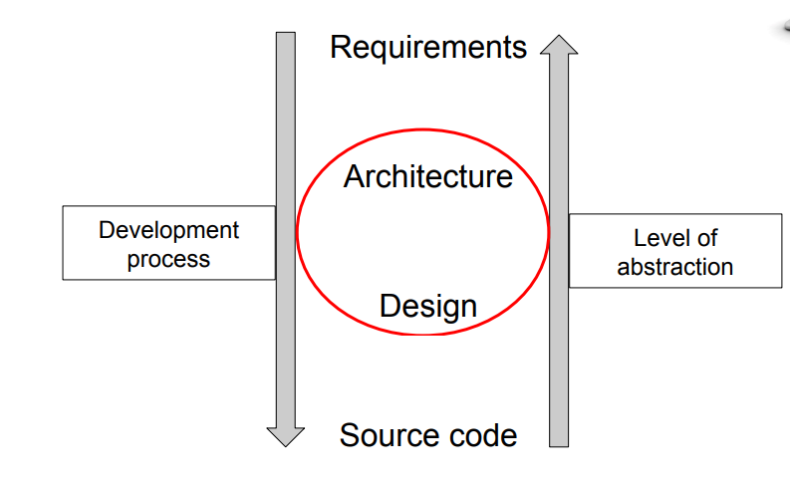
Architecture vs. design

Slide 5
Analysis vs. Design
Analysis
Asks “what is the problem?”
what happens in the current system?
what is required in the new system?
Results in a detailed understanding of:
Requirements
Domain Properties
Focuses on the way human activities are conducted

Slide 6
Analysis vs. Design
Design
Investigates “how to build a solution”
How will the new system work?
How can we solve the problem that the analysis identified?
Results in a solution to the problem
A working system that satisfies the requirements
Hardware + Software + Peopleware
Focuses on building technical solutions
Separate activities, but not necessarily sequential
…and attempting a design usually improves understanding of the problem

Slide 7
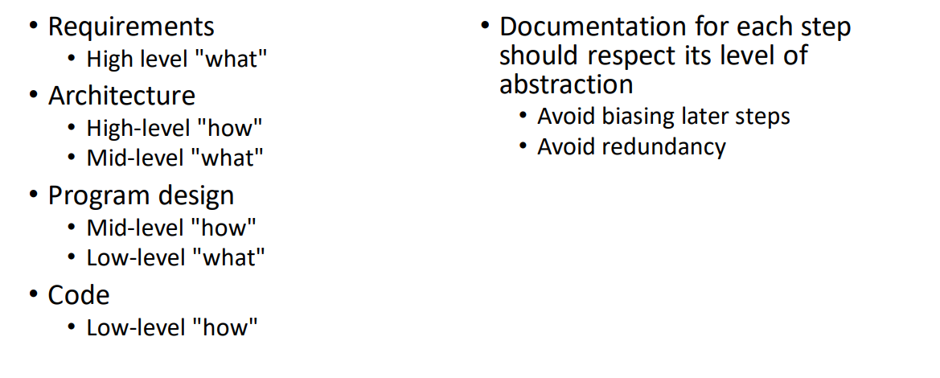
Levels of abstraction

Slide 8
Architecture vs. design
Architecture (what is developed?)
High-level view of the overall system:
What components do exist?
What are the protocols between components?
What type of storage etc.?
Design (how are the components developed?)
Considers individual components:
Data representation
Interfaces, Class hierarchy

Slide 9
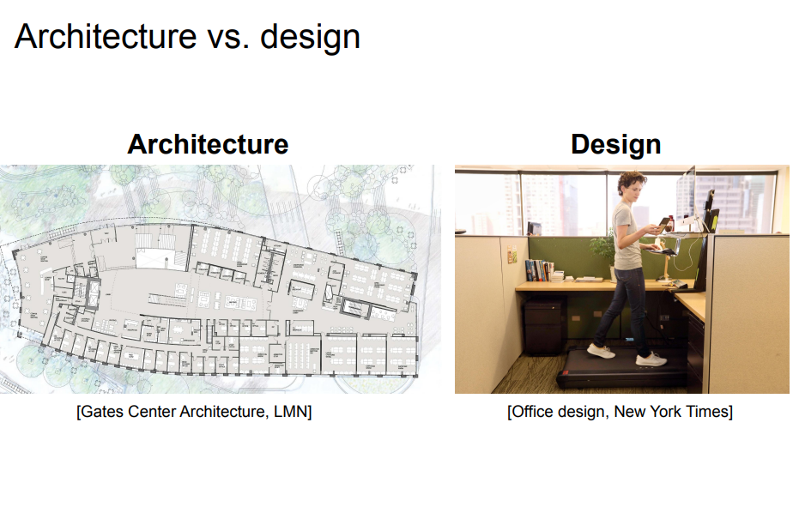

Slide 10
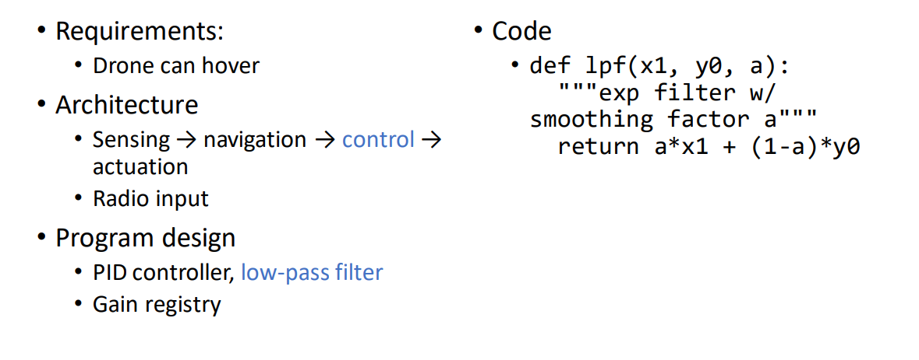
Example

Slide 11
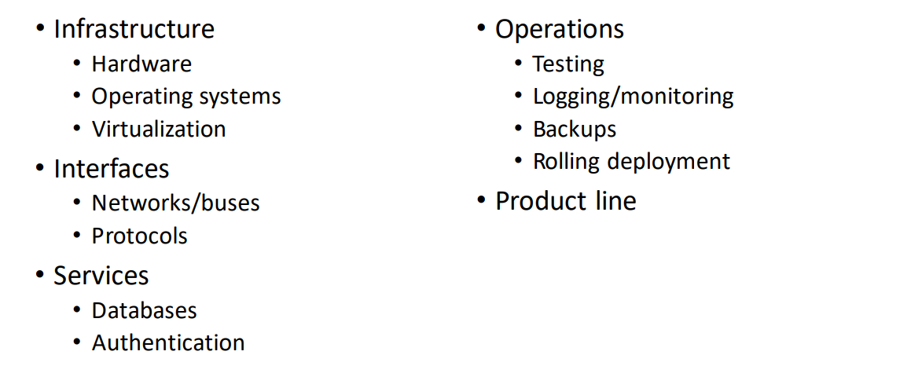
Architectural considerations

Slide 12

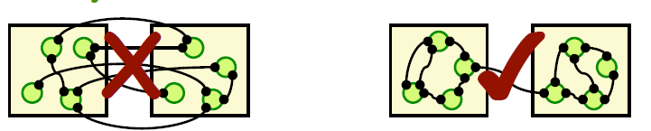
Architectural Building blocks
Architectural Building blocks:
A good architecture:
Minimizes coupling between modules:
Goal: modules don’t need to know much about one another to interact
Low coupling makes future change easier
Maximizes the cohesion of each module
Goal: the contents of each module are strongly inter-related
High cohesion makes a module easier to understand
Coupling and Cohesion

Slide 13
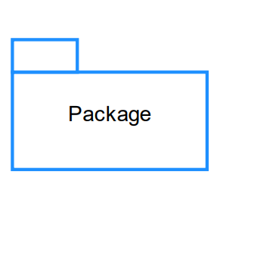
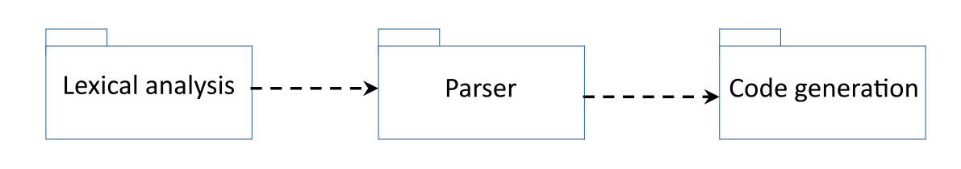
Package
General grouping of system elements
Appropriate for denoting subsystem at conceptual level
Conceptual diagram

Slide 14
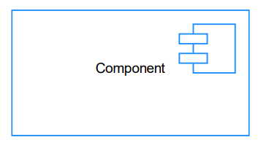
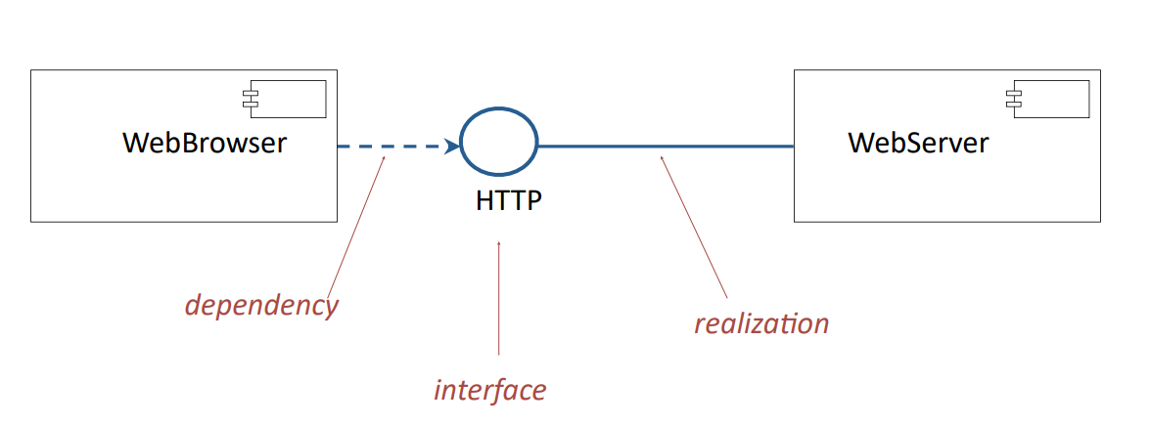
Component
Replaceable part of a system
Conforms to and realizes a set of interfaces
• An implementation of a subsystem
• Could be replaced by another component that realizes the same interfaces, and system would still function
Components realize interfaces, are assembled into systems
interface diagram

Slide 15
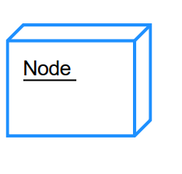
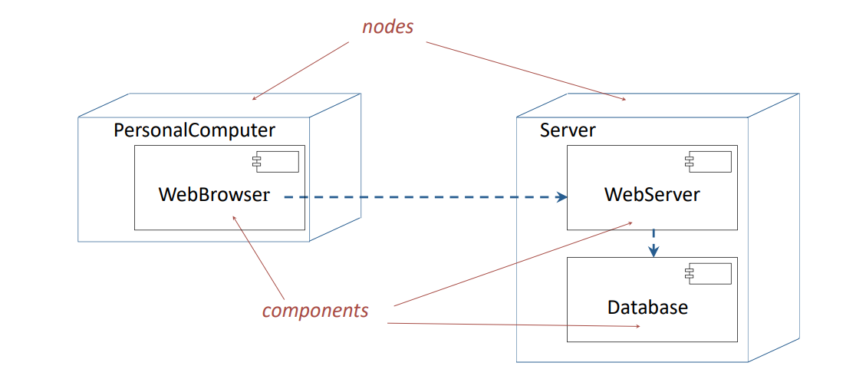
Node
Physical element that exists at runtime, provides a computational resource
• Computer
• Smartphone
• Network router
• Components live on nodes
deployment diagram

Slide 16
Framework
A framework, or software framework, is a platform that provides a foundation for developing software applications. Think of it as a template of a working program that can be selectively modified by adding code.
A framework is a partially complete software (sub-) system that is intended to be instantiated.
It defines the architecture for a family of (sub-) systems and provides the basic building blocks to create them.
Web app framework.
React, Angular, Vue , Spring boot, Asp.net Core, Django, Rails
Mobile app framework.
Flutter React Native
Technology framework
. Selenium
Enterprise architecture framework.
ITIL,IT4IT,COBIT,ISO20000,Six Sigma
The Zachman Framework , Open Agile Architecture (O-AA), The Open Group Architectural Framework (TOGAF),
Database framework.
Hadoop by Apache that stores and distributes large data sets across several servers
Testing framework.
Selenium , WebdriverIO , Cypress
AI application development. TensorFlow , PyTorch
Cross-platform native apps - . Xamarin

Slide 17
Architectural Patterns
The fundamental problem to be solved with a large system is how to break it into chunks manageable for human programmers to understand, implement, and maintain.
An architectural pattern is a general, reusable solution to a commonly occurring problem in software architecture within a given context. Architectural patterns are similar to software design pattern but have a broader scope.

Slide 18
Architectural Pattern Vs Design Pattern
An architectural Pattern expresses a fundamental structural organization schema for software systems. It provides a set of predefined subsystems, their responsibilities, and includes rules and guidelines for organizing the relationships between them.
A design pattern provides a scheme for refining the subsystems or components of a software system, or the relation ships between them. It describes a commonly recurring structure of communicating components that solves a general design problem within a particular context.

Slide 19
Software Architectures
Architectural Styles
Pipe and filter
Object oriented:
Client-Server; Object Broker
Event based
Layered:
Designing Layered Architectures
Repositories:
Blackboard, MVC

Slide 20
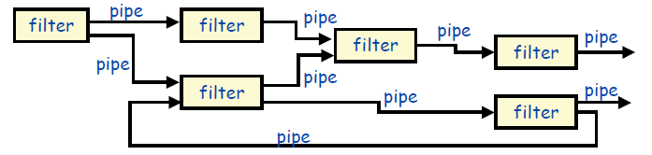
Pipe-and-filter
This pattern can be used to structure systems which produce and process a stream of data.
Each processing step is enclosed within a filter component.
Data to be processed is passed through pipes.
These pipes can be used for buffering or for synchronization purposes.
Usage:
UNIX shell commands – Grep Command
Compilers:
Lexical Analysis -> parsing -> semantic analysis -> code generation
Signal Processing
Workflows in bioinformatics.
Notes:
Easy to understand the overall input/output behavior of a system as a simple composition of the behaviors of the individual filters.
• They support reuse, since any two filters can be hooked together, provided they agree on the data that is being transmitted between them

Slide 21
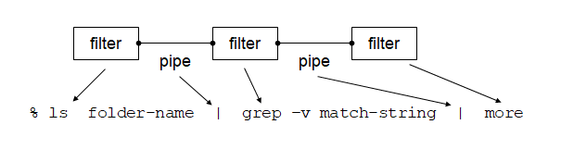
Pipe-and-filter – Example

Slide 22
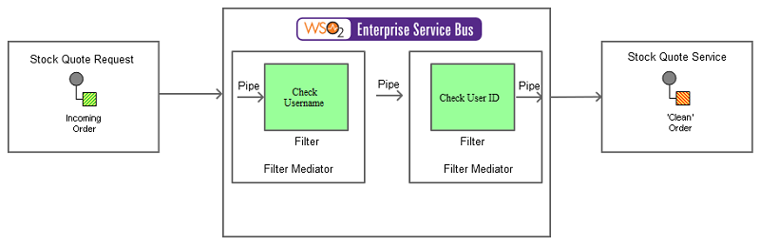
Pipe-and-filter – Example

Slide 23
Pipe and Filter Advantages
• Systems can be easily maintained and enhanced, since new filters can be added to existing systems and old filters can be replaced by improved ones.
• They permit certain kinds of specialized analysis, such as throughput and deadlock analysis.
• The naturally support concurrent execution

Slide 24
Pipe and Filter Disadvantages
• Not good choice for interactive systems, because of their transformational character.
• Excessive parsing and unparsing leads to loss of performance and increased complexity in writing the filters themselves

Slide 25
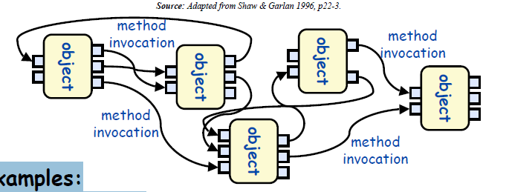
Object Oriented Architectures
Examples:
abstract data types
Interesting properties
data hiding (internal data representations are not visible to clients)
can decompose problems into sets of interacting agents
can be multi-threaded or single thread
Disadvantages
objects must know the identity of objects
they wish to interact with

Slide 26
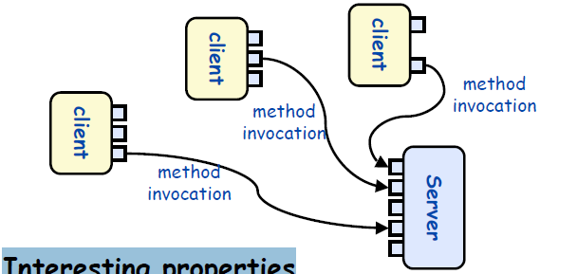
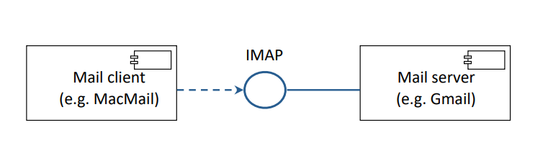
Variant 1: Client Server
This pattern consists of two parties;
a server and
multiple clients.
The server component will provide services to multiple client components.
Clients request services from the server and the server provides relevant services to those clients.
The server continues to listen to client requests.
Usage
Online applications such as email, document sharing and banking.
Disadvantages
Client objects must know the identity of the server

Slide 27
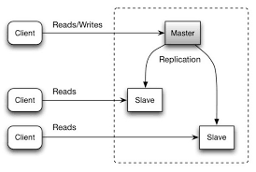
Variant 2- Master-slave pattern
This pattern consists of two parties;
master
slaves.
The master component distributes the work among identical slave components, and computes a final result from the results which the slaves return.
Usage
In database replication, the master database is regarded as the authoritative source, and the slave databases are synchronized to it.
Peripherals connected to a bus in a computer system (master and slave drives).

Slide 28
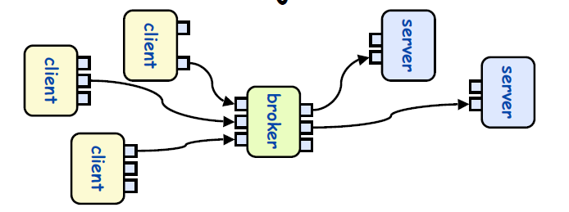
Variant 3: Object Brokers
Interesting properties
 Adds a broker between the clients and servers
 Clients no longer need to know which server they are using
 Can have many brokers, many servers.
Disadvantages
 Broker can become a bottleneck
 Degraded performance
Usage
Message broker software such as Apache ActiveMQ, Apache Kafka, RabbitMQ and JBoss Messaging.
Notes:
This pattern is used to structure distributed systems with decoupled components.
These components can interact with each other by remote service invocations.
A broker component is responsible for the coordination of communication among components.
Servers publish their capabilities (services and characteristics) to a broker.
Clients request a service from the broker, and the broker then redirects the client to a suitable service from its registry.

Slide 29
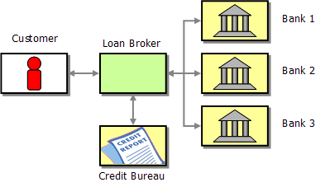
Broker Architecture Example

Slide 30
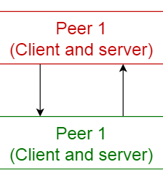
Peer-to-peer pattern
In this pattern, individual components are known as peers.
Peers may function both as a client, requesting services from other peers, and as a server, providing services to other peers.
A peer may act as a client or as a server or as both, and it can change its role dynamically with time.
Usage
File-sharing networks such as Gnutella and G2)
Multimedia protocols such as P2PTV and PDTP.
Proprietary multimedia applications such as Spotify.

Slide 31
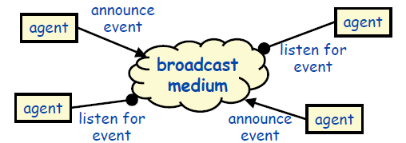
Event based (implicit invocation)
Examples
 debugging systems (listen for particular breakpoints)
 database management systems (for data integrity checking)
 graphical user interfaces
Interesting properties
 announcers of events don’t need to know who will handle the event
 Supports re-use, and evolution of systems (add new agents easily)
Disadvantages
 Components have no control over ordering of computations

Slide 32
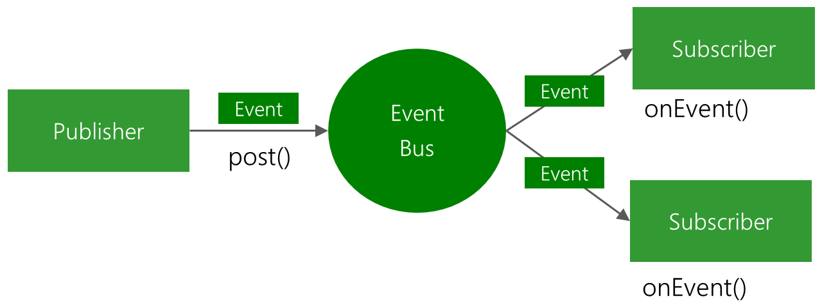
Event-bus pattern
This pattern primarily deals with events and has
4 major components;
event source,
event listener,
channel
event bus.
Sources publish messages to particular channels on an event bus.
Listeners subscribe to particular channels.
Listeners are notified of messages that are published to a channel to which they have subscribed before.
Usage
Android development
Notification services
debugging systems (listen for particular breakpoints)
database management systems (for data integrity checking)
graphical user interfaces

Slide 33
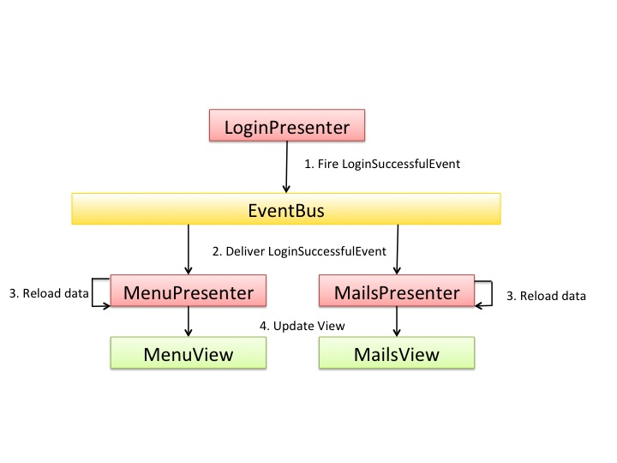
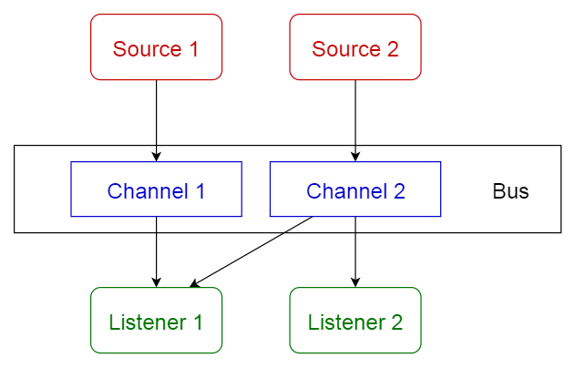
Event-bus pattern-Example

Slide 34
Layered pattern
This pattern is also known as n-tier architecture pattern.
It can be used to structure programs that can be decomposed into groups of subtasks, each of which is at a particular level of abstraction.
Each layer provides services to the next higher layer.
Usage
General desktop applications.
E commerce web applications.

Slide 35
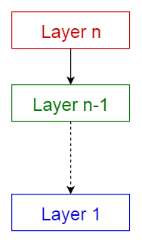
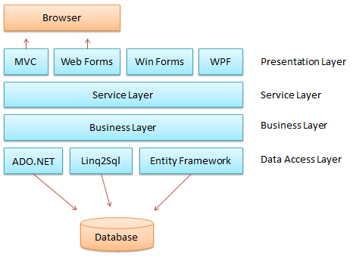
Common layers of a general information system
Presentation layer (also known as UI layer)
Application layer (also known as service layer)
Business logic layer (also known as domain layer)
Data access layer (also known as persistence layer)

Slide 36
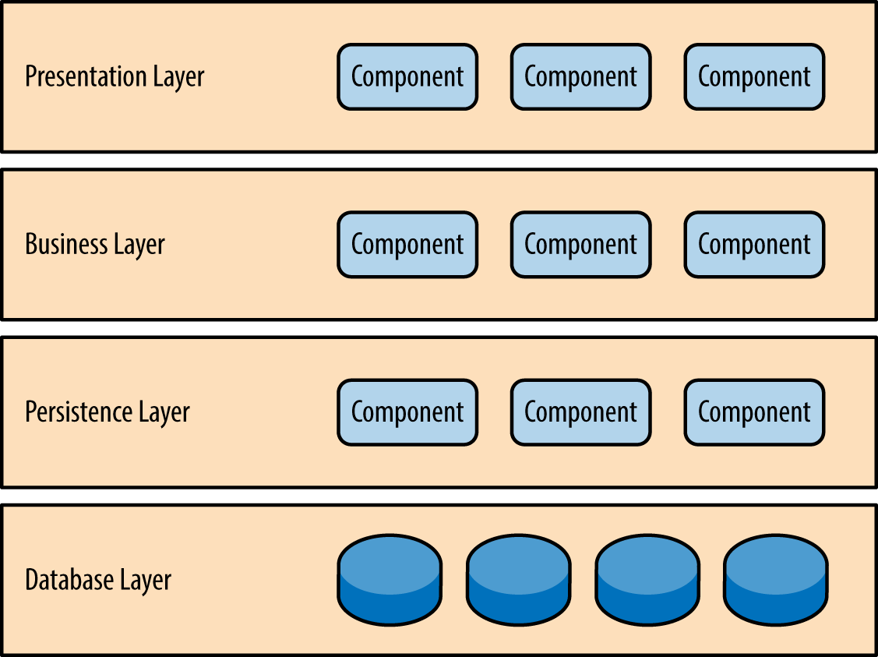
Layered pattern
Different levels of abstraction
Requests go down, notifictions go back up
Possible to define stable interaces between layers
May add or change layers over time

Slide 37
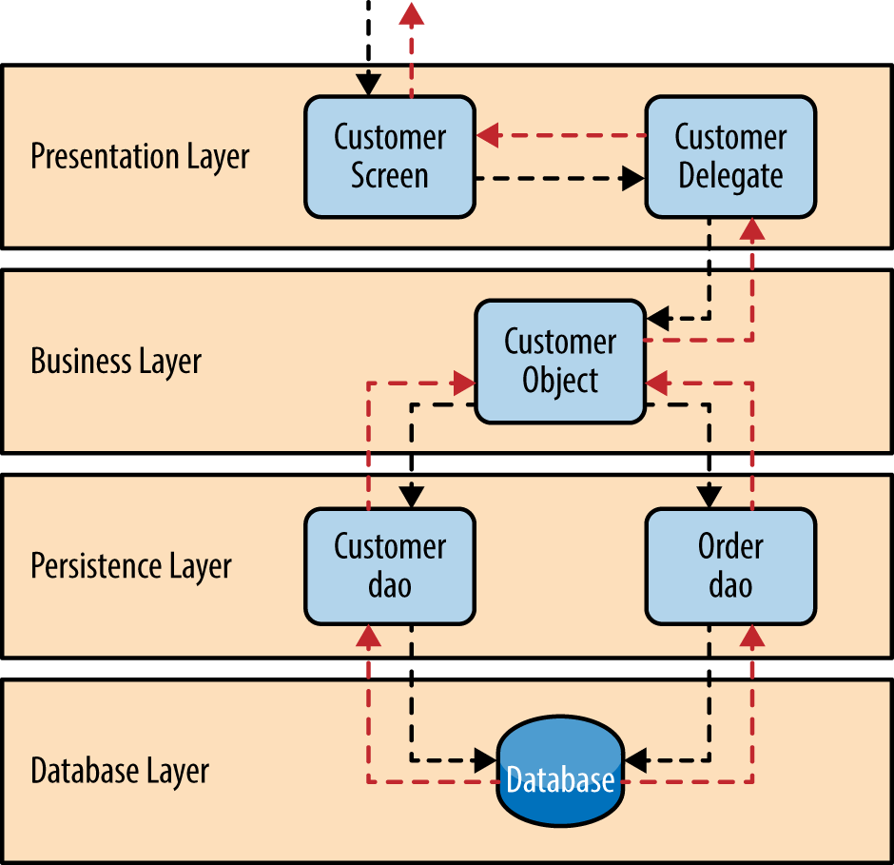
Layered pattern
Start with the lowest later
Build layers on top
Use same level of abstraction within each layer
Componenets cannot spread over two layers
Keey lower layers lean
Specify interfaces for each layer
Handle errors at the lowest level possible

Slide 38
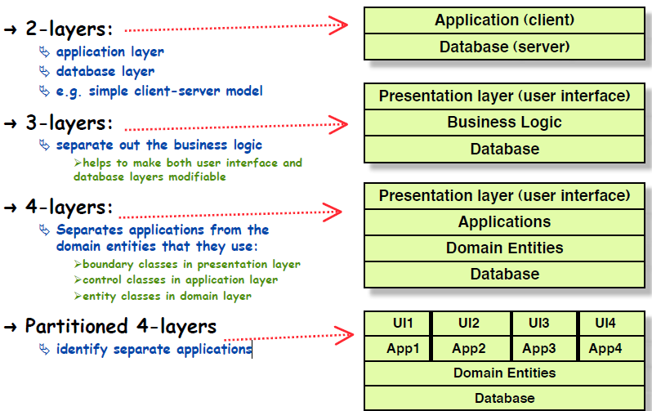
How many layers?

Slide 39
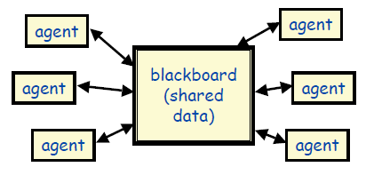
Repositories
Examples
 databases
 blackboard expert systems
 programming environments
➲ Interesting properties
 can choose where the locus of control is (agents, blackboard, both)
 reduce the need to duplicate complex data
➲ Disadvantages
 blackboard becomes a bottleneck

Slide 40
Repository Style Examples
• Information Systems
• Programming Environments
• Graphical Editors
• AI Knowledge Bases
• Reverse Engineering Systems

Slide 41
Variant: Model-View-Controller
This pattern, also known as MVC pattern, divides an interactive application in to 3 parts as,
model — contains the core functionality and data
view — displays the information to the user (more than one view may be defined)
controller — handles the input from the user
Usage:
Architecture for World Wide Web applications in major programming languages.
Web frameworks such as Django and Rails.
JavaSpring boot, PHP Laravel, Asp.NET MVC)

Slide 42
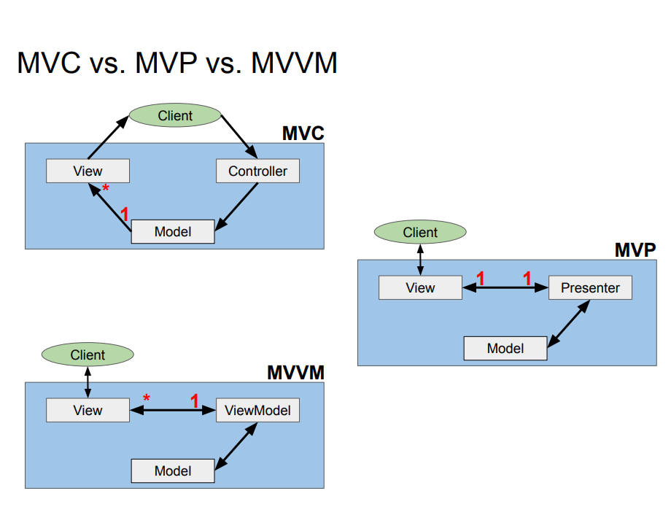

Slide 43
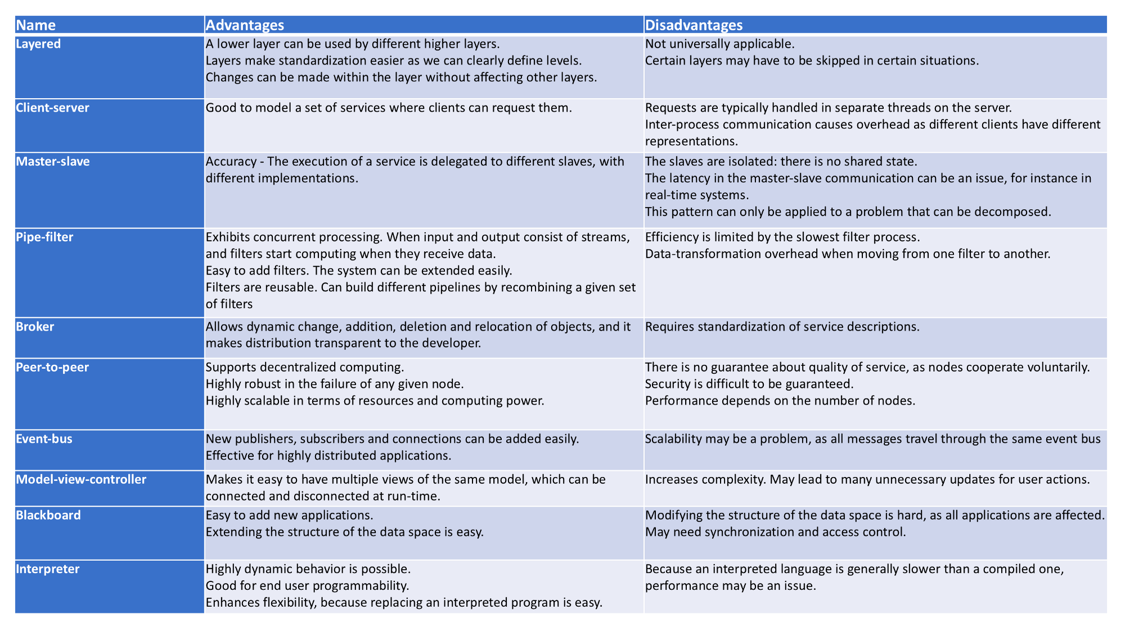

Slide 44


